Slide 1
Using Facebook Friends to Predict Civil Engagement
Nate Jacobs & Ryan Thompson

Slide 2
What is Civil Engagement?
Bowling Alone – Robert Putnam.
Social Capital.
Network of relationships that allow society to function.
Shared Identity.
Trust.
Norms & Values.
Used as a measure to explain the societal performance of specific groups.

Slide 3
Guiding Questions
Does friendship across higher and lower economic classes affect engagement in the community?
Does the age at which these friendships are developed affect this engagement later in life?
Does the insular nature of friend groups have a quantifiable effect on civil engagement?

Slide 4
Data
Humanitarian Data Exchange - Social Capital Atlas
Data were aggregated from Facebook at the county level within the United States (N = 3089).
26 original dimensions, later pruned categorical variables.
51 Outliers removed from data.
Oblique Factor Rotation performed.
4 Complex Dimensions remained after rotation.
Over 90% of the data were maintained.
One Response Factor loading two dimensions
Volunteering Rate and Civic Organization Participation

Slide 5
Factors
Intrinsic Dimensionality of 6 per Jolliffe's Criterion
F1 – Wealth Exposure
F2 – Standardization
F3 – Childhood Wealth Exposure
F4 – Friending Bias
F5 – Wealthy Friending Bias
F6 – Group Support Availability

Slide 6
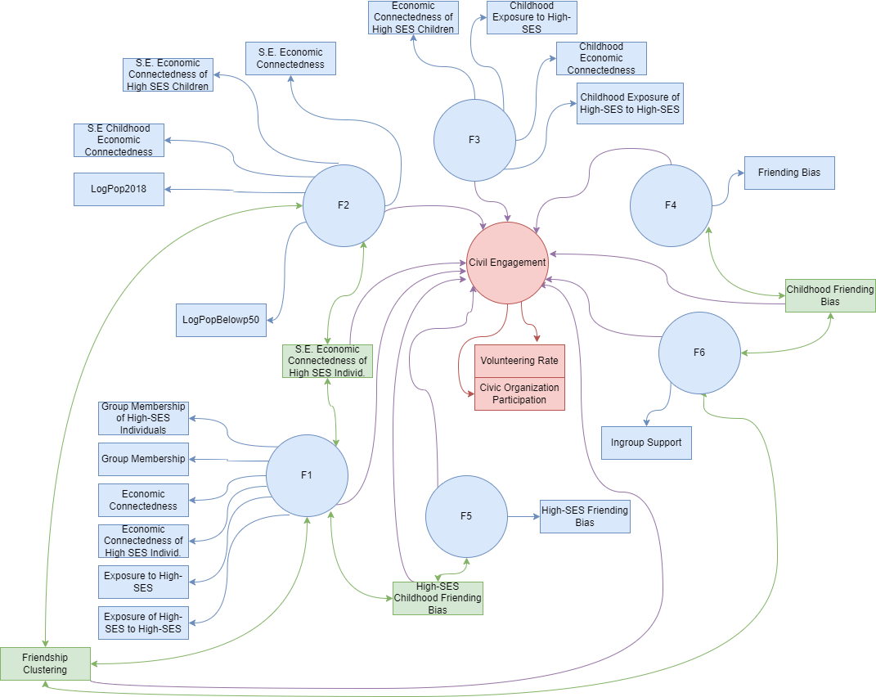

Slide 7
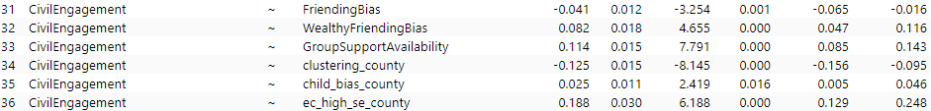
Predictor Estimates

Slide 8
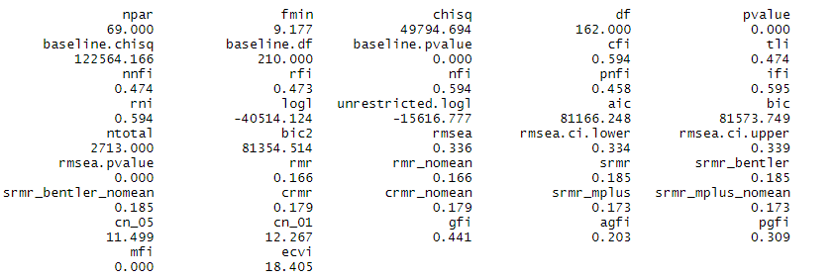
Fit Measures

